Slide 1






Spoiled Tomatillos
http://www.url.com
Group 26
Moderator
spoiled
tomatillos
User Login
Username
Password
Login

Slide 2

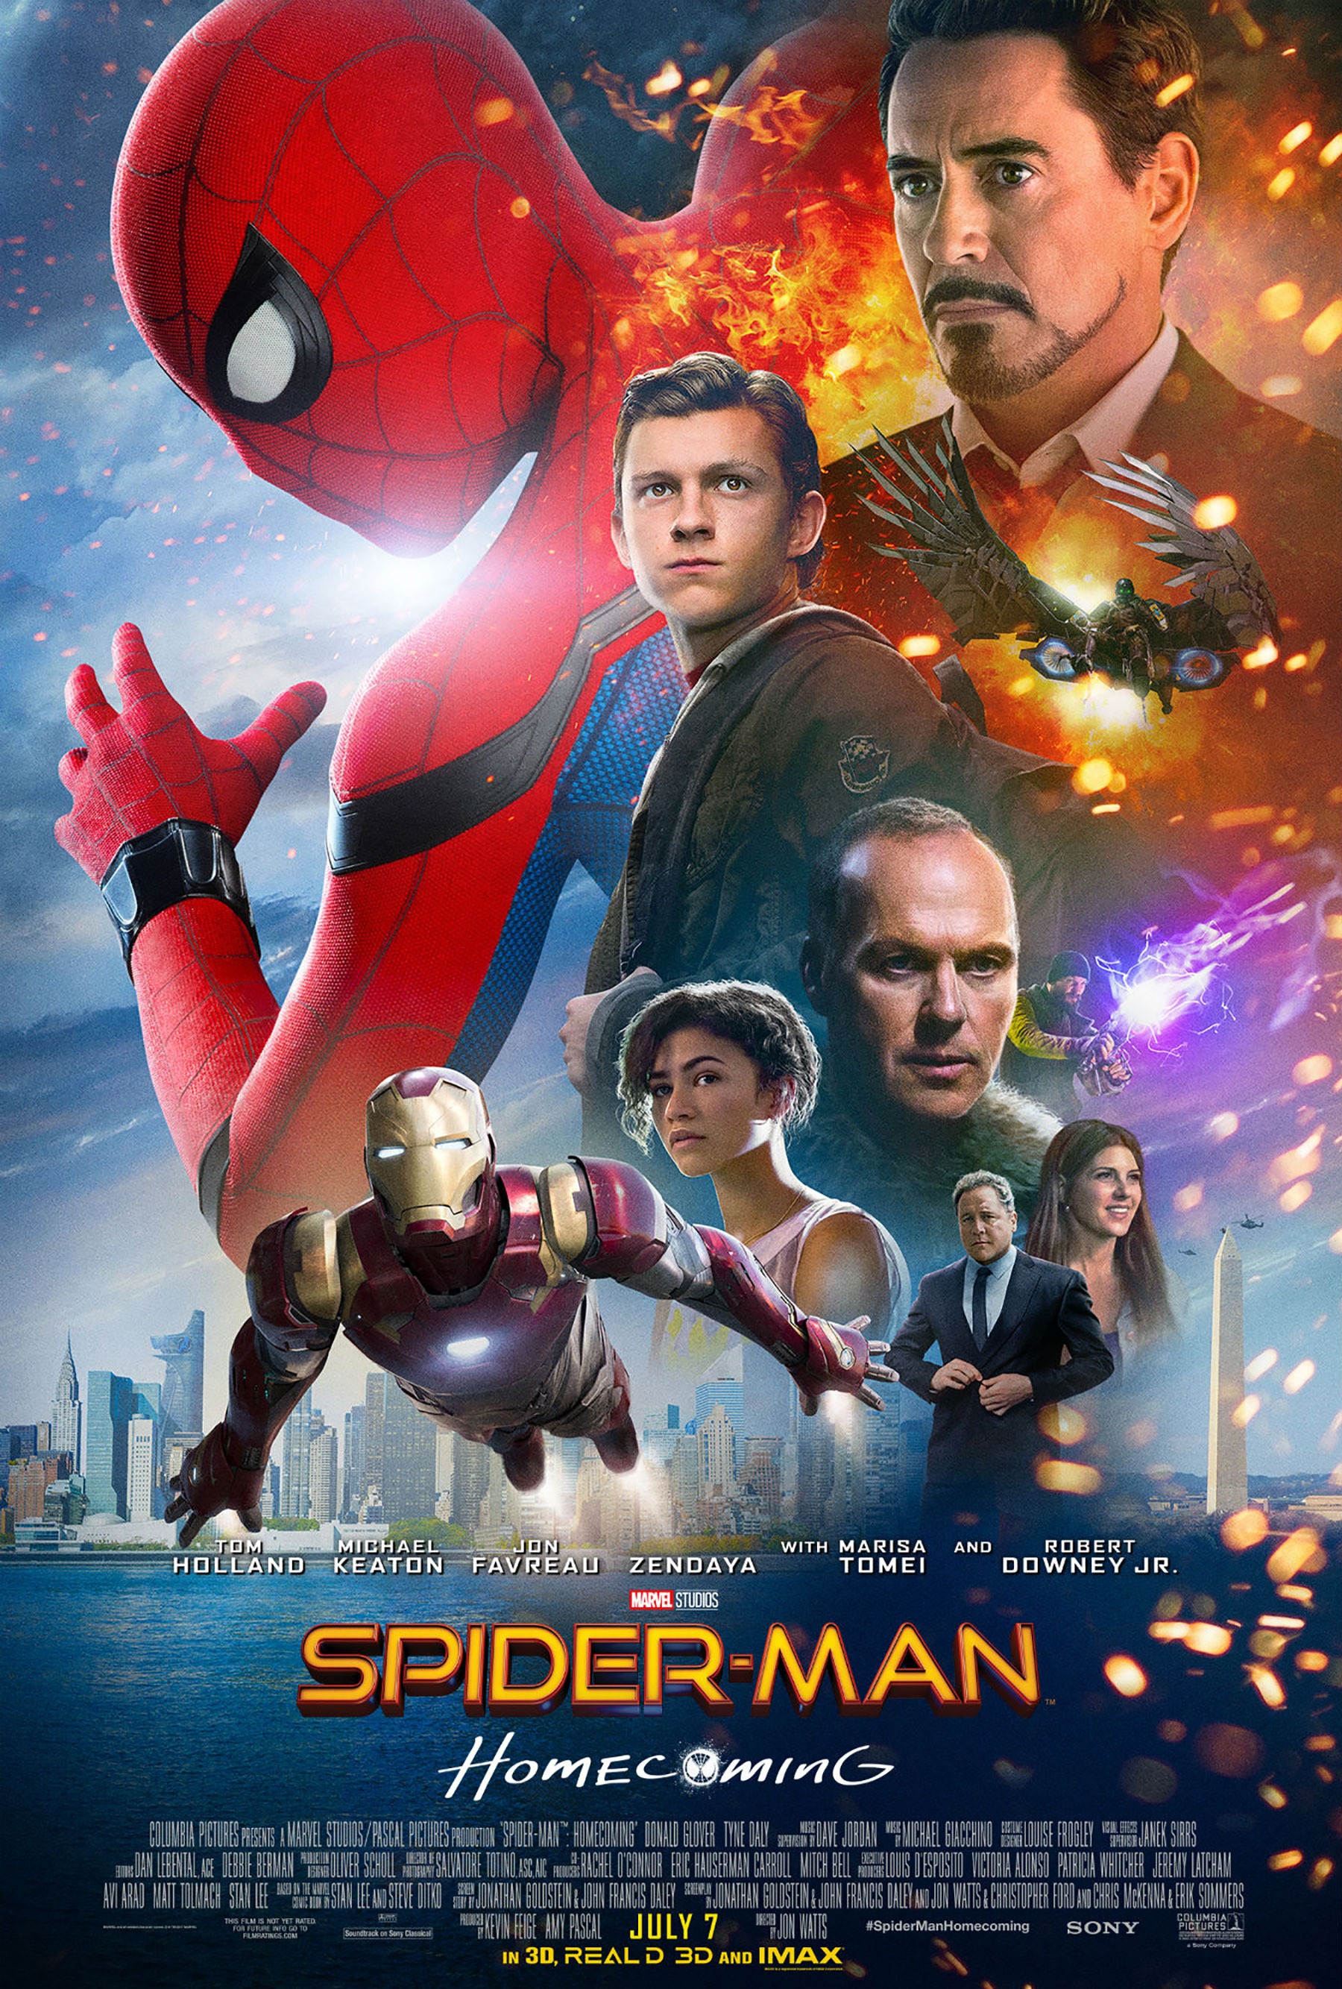


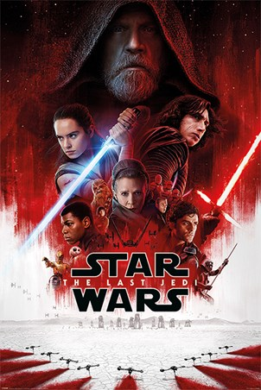

Spoiled Tomatillos
http://www.url.com
Group 26
Moderator
tomatillos
Moderator Actions
spoiled
Feed
My Profile
My Groups
Logout
search
Suggested For You
New Releases
Social Feed
User1 liked Spiderman
User1 liked Star Wars
User2 liked Star Wars
User3 liked Star Wars
User3 liked Jumanji
User3 liked Jaws

Slide 3
Spoiled Tomatillos
http://www.url.com
Group 26
Moderator
tomatillos
Moderator Actions
spoiled
Feed
My Profile
My Groups
Logout
Review Flagged Comments
Username | Comment | Review?
User1 | “This movie sucks!”
User2 | “I didn’t like this actress”
User3 | “F&@*#^!!”
User4 | “I’m not a fan of this movie”
User5 | “I don’t like you!”
User6 | “This was bad.”
User7 | “I hate tomatillos.”

Slide 4
Spoiled Tomatillos
http://www.url.com
Group 26
Moderator
tomatillos
Moderator Actions
spoiled
Feed
My Profile
My Groups
Logout
Review Flagged Comments
Username | Comment | Review?
User1 | “This movie sucks!”
User2 | “I didn’t like this actress”
User3 | “F&@*#^!!”
User4 | “I’m not a fan of this movie”
User5 | “I don’t like you!”
User6 | “This was bad.”
User7 | “I hate tomatillos.”
Review User3’s Comment
!
“F&@!*#&!!!”
Delete
Cancel

Slide 5
Spoiled Tomatillos
http://www.url.com
Group 26
Moderator
tomatillos
Moderator Actions
spoiled
Feed
My Profile
My Groups
Logout
Review Flagged Comments
Username | Comment | Review?
User1 | “This movie sucks!”
User2 | “I didn’t like this actress”
User4 | “I’m not a fan of this movie”
User5 | “I don’t like you!”
User6 | “This was bad.”
User7 | “I hate tomatillos.”

